Slide 1


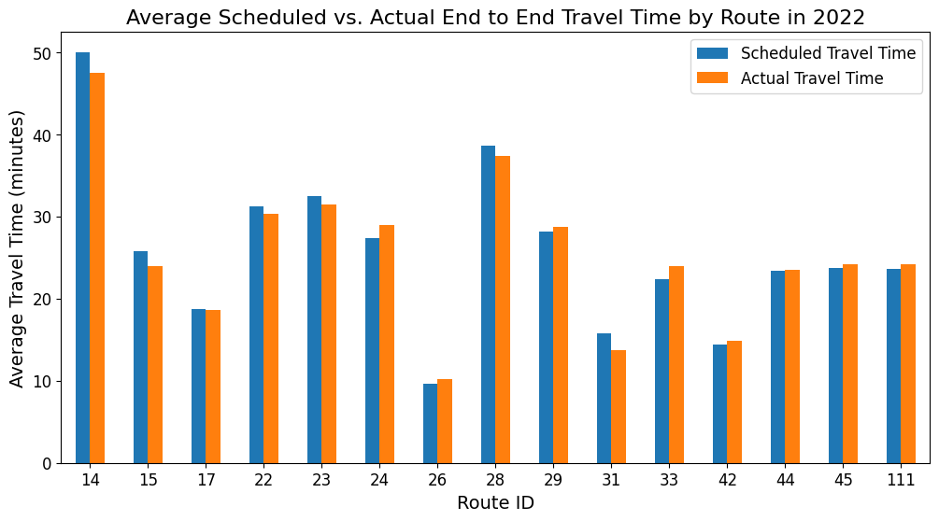
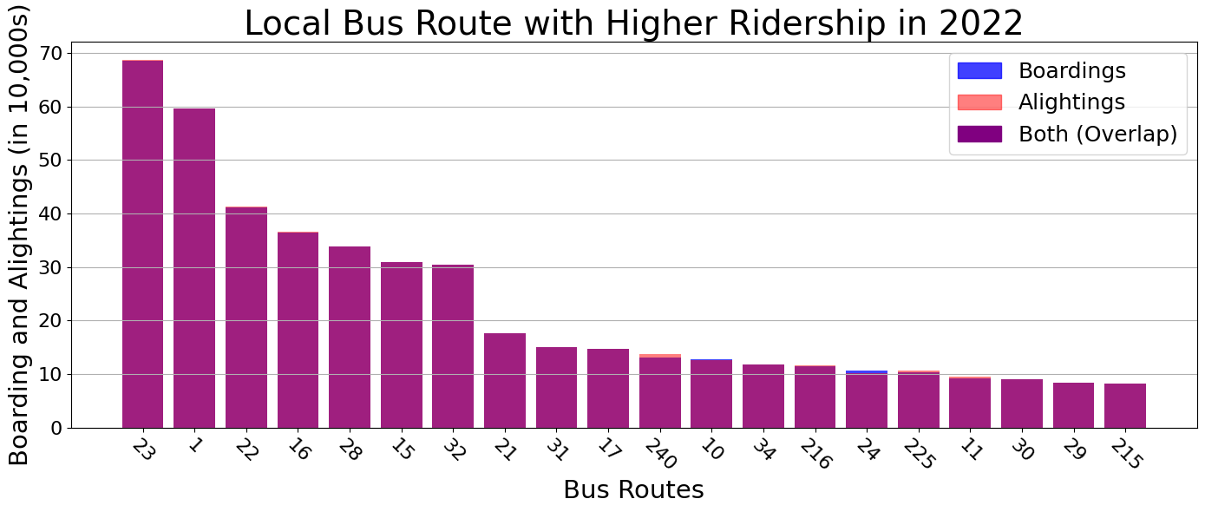
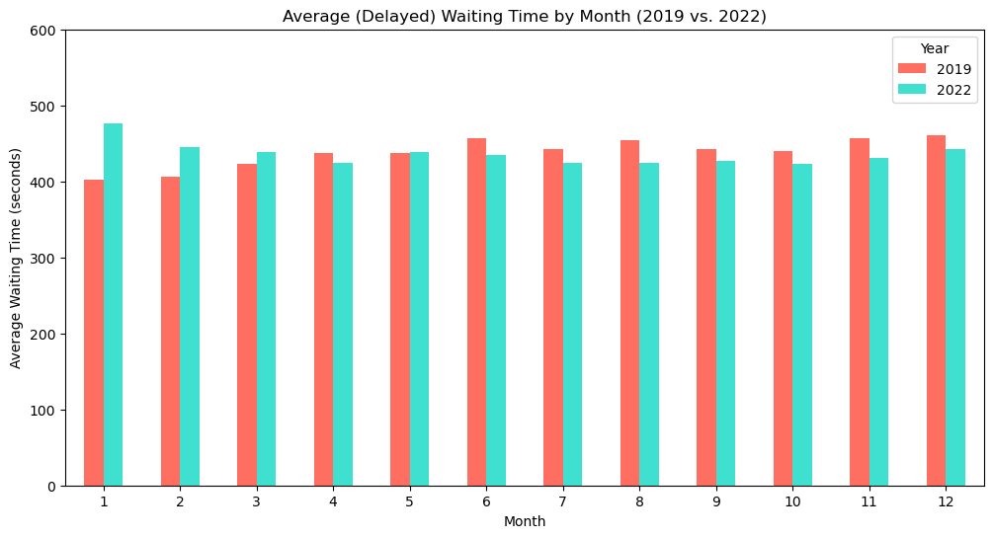
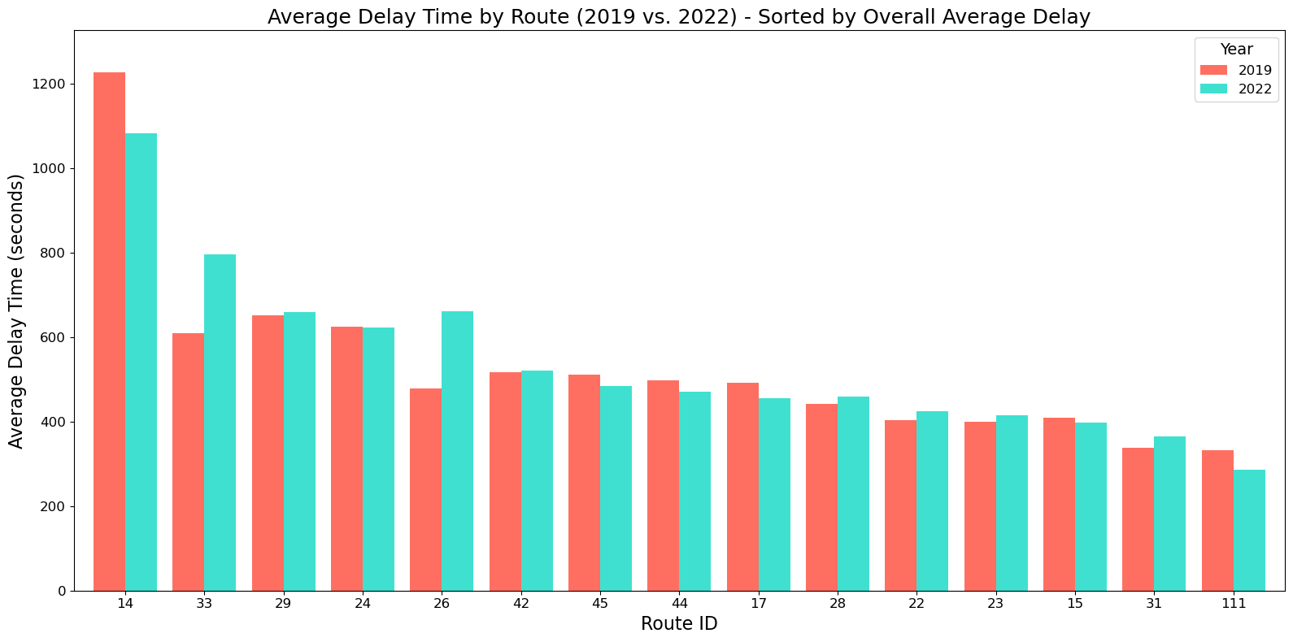
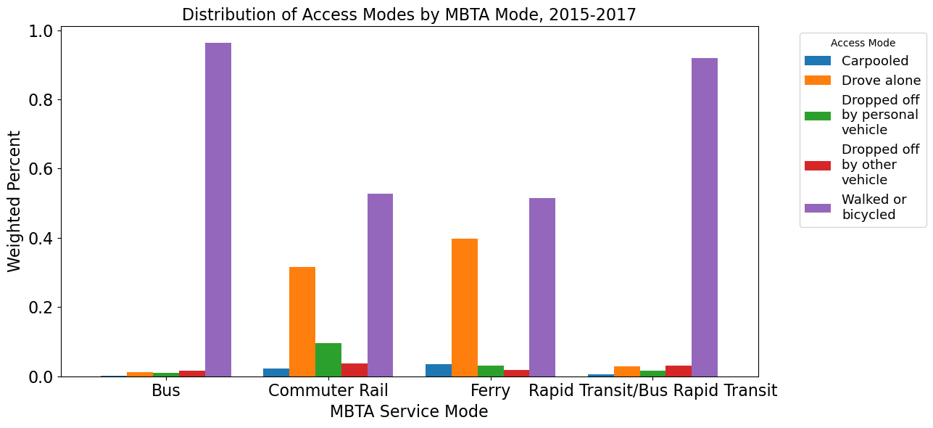
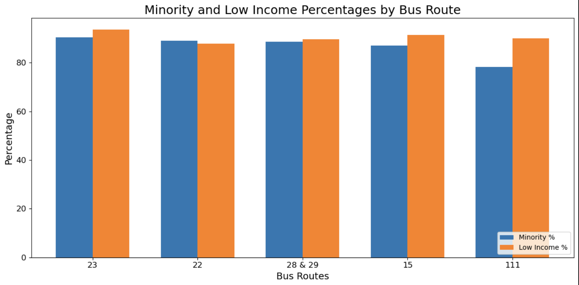
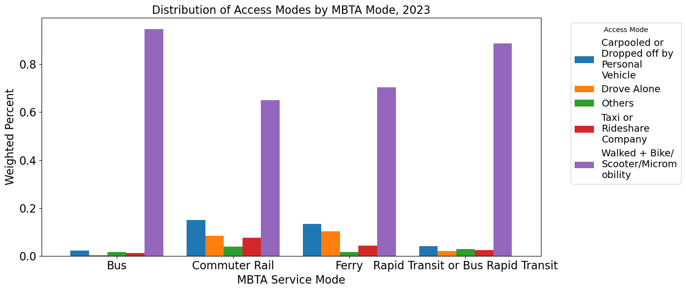
GBH: Boston Bus Equity
Project Summary
This project aims to deliver a detailed analysis of the Massachusetts Bay Transportation Authority (MBTA) bus performance between 2019 and 2023. The main focus is to compare the ridership and reliability data for each bus route between the years. The datasets utilized for this project were sourced from the MBTA Open Data Portal.
Project Results
Conclusion
Through this analysis, we have identified key trends and patterns in bus performance and service equity which we can then inform future improvements to the MBTA system. To address these disparities, it is crucial for policy makers and the MBTA to prioritize improvements in the routes serving high-demand areas and Environmental Justice communities. Investments in operational improvements, such as better scheduling, more frequent service, and targeted resources for delayed routes, can help reduce service gaps and ensure that all Boston residents have access to reliable public transportation.
Project Questions
Key Questions:
1) What is the ridership per bus route?
2) What are the end-to-end travel times for each bus route in the city?
2.1) On average, how long does an individual have to wait for a bus (on time vs. delayed)?
2.2) What is the average delay time of the target bus routes (top 30 by ridership)?
3) Are there disparities in the service levels of different routes (which lines are late more often than others)?
3.1) If there are service level disparities, are there differences in the characteristics of the people most impacted? (Map over census tract)
3.2) Can we chart changes over time?
Client and Mentor
Client: Paul Singer - Senior Editor, GBH News
PM: Herbert Zhang
TM: Julissa Mijares
Class: DS 701
Team Members
Youran Geng (MSDS 2025, yg779xw@bu.edu)
Huihao Xing (MSDS 2025, huxing@bu.edu)
Mi-Ru Youn (MSDS 2025, miruyoun@bu.edu)
Chen Yu Liu (MSDS 2025, erioe@bu.edu)
Namika Takada (MSDS 2025, ntakada@bu.edu)
Tech Stack/Processes
Program Languages: Python
Libraries: Pandas, Numpy, Matplotlib

